Slide 1
Unit 3A
Human Form & Function
Cells, metabolism & regulation
Protein synthesis

Slide 2

Study Guide
Read:
Our Human Species (3rd edtn)
Chapter 18, section 7
Complete:
Human Biological Science Workbook
Topic 2 – Protein Synthesis

Slide 3
Protein synthesis
Protein synthesis (also known as gene expression ) is the conversion of the genetic code carried by DNA into an end product i.e. usually a protein.
Protein synthesis involves the processes of transcription and translation.

Slide 4
Proteins
A protein is a member of a family of organic compounds consisting of long chains of amino acids.
Proteins are essential for life – they have numerous important structural roles e.g. muscles, and many are enzymes, which regulate all our vital metabolic processes.

Slide 5
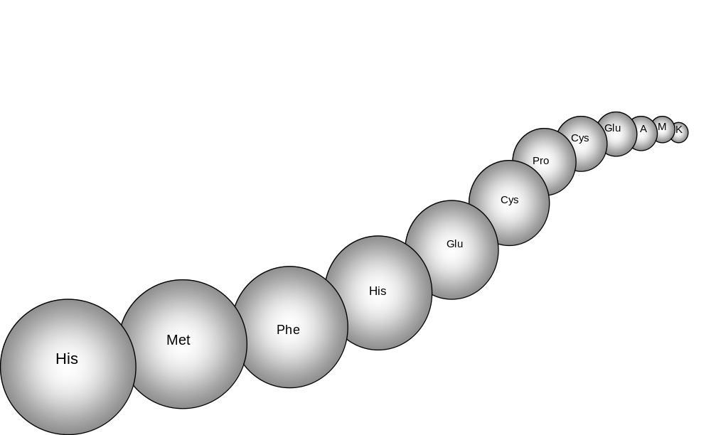
Proteins are long chains of amino acids
The sequence of bases in a gene is a code instructing the cell how to construct a particular protein – i.e. the number of amino acids and the order in which they are to be assembled.

Slide 6
The twenty standard amino acids
Alanine (Ala) Arginine (Arg) Asparagine (Asn) Aspartic acid (Asp) Cysteine (Cys) Glutamic acid (Glu) Glutamine (Gln) Glycine (Gly) Histidine (His) Isoleucine (Ile) | Leucine (Leu) Lysine (Lys) Methionine (Met) Phenylalanine (Phe) Proline (Pro) Serine (Ser) Threonine (Thr) Tryptophan (Trp) Tyrosine (Tyr) Valine (Val)

Slide 7
What is DNA?
DNA = deoxyribonucleic acid
DNA carries the instructions for making all the structures and materials the body needs to function - in particular, proteins.

Slide 8
The structure of DNA
The shape of the molecule is described as a “double helix”.
The building blocks of DNA are the nucleotides.

Slide 9
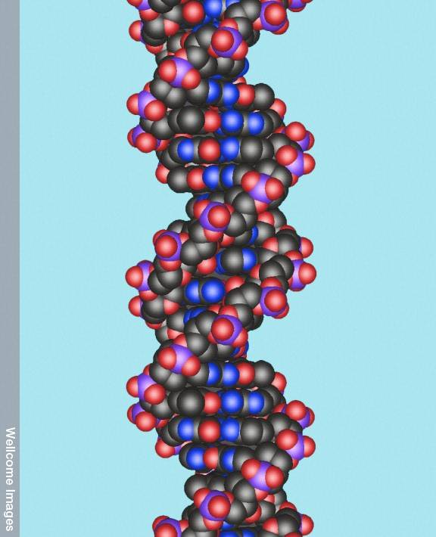
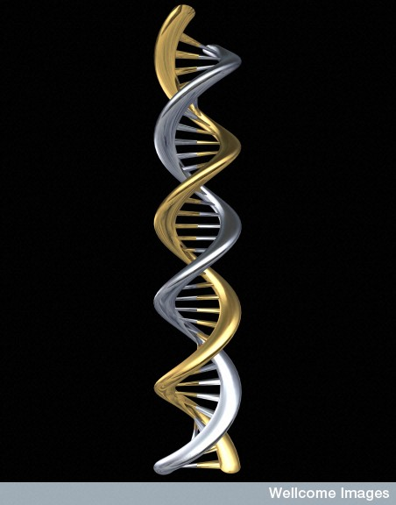
DNA - the double helix
Wellcome Images – Peter Artymiuk
Wellcome Images – Oliver Burston

Slide 10
The ladder model
If the helix was untwisted it would look like a ladder.
The side rails of the ‘ladder’ are made of alternating molecules of phosphate and a five-carbon sugar (ribose).
The rungs of the ladder are paired nitrogen bases.

Slide 11
The DNA backbone
The two side rails of the ladder run in opposite directions, which can be identified by the end of the rail which is either a three base (3’) end, or a five base (5’) end. [3 & 5 refer to the carbon atoms in the sugar molecule that form a bond with the adjoining phosphate.]
One strand runs from 3’ to 5’ and the opposite strand, from 5’ to 3’.

Slide 12
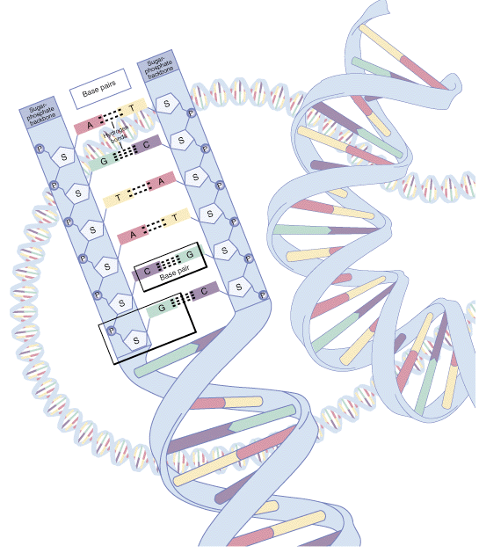
Nucleotides are the structural units of DNA and consist of one phosphate molecule, one sugar molecule and one nitrogen base.
Backbone
Base pair
Nucleotide
NIH - National Human Genome Research Institute

Slide 13
A nucleotide
P
3'
G
Nitrogen base
5'
H
A
T
Nucleotide
S
S
S
Pentose sugar
P
Phosphate
T
P
P
P
5'
H
S
T
A
3'
S
S
P
P
C
H
G
5'
C
S
S
O
4'
C
C
1'
3'
5'
P
3'
C
C
2'
OH

Slide 14
The nitrogen bases
Each “rung” of the DNA ladder is formed from two nitrogen bases.
There are four bases – adenine (A), thymine (T), cytosine (C), and guanine (G).

Slide 15
The base pairing rule
The base adenine always bonds with thymine (A-T), and cytosine always bonds with guanine (C-G).

Slide 16
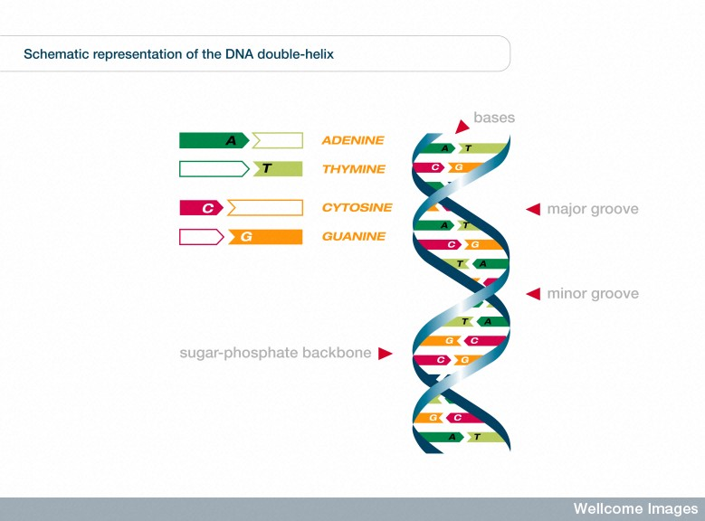
The structure of the double helix
Wellcome Images - Pete Jeffs

Slide 17
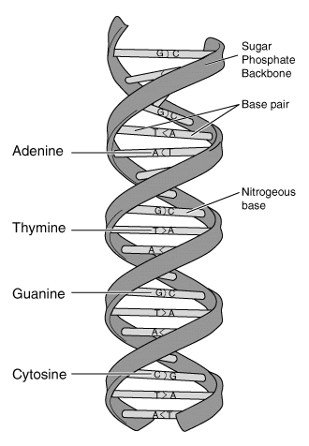
The base pairs
In DNA, cytosine and guanine are bound together by 3 hydrogen bonds, whereas adenine and thymine are bound by 2 hydrogen bonds.
NIH - National Human Genome Research Institute

Slide 18
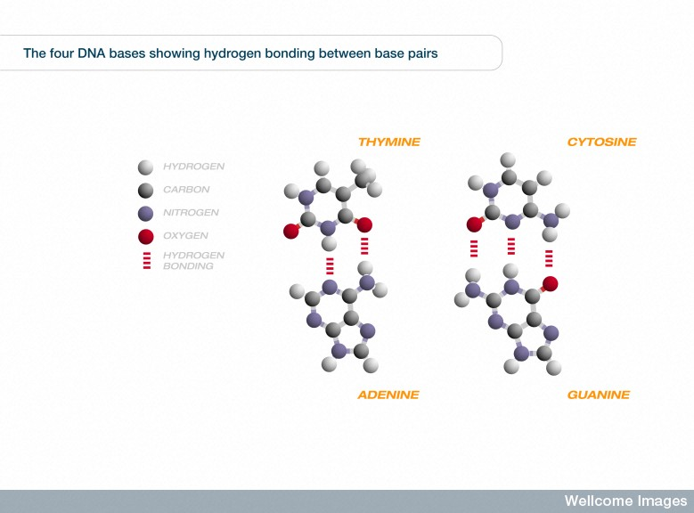
The base pairs
Wellcome Images - Pete Jeffs

Slide 19
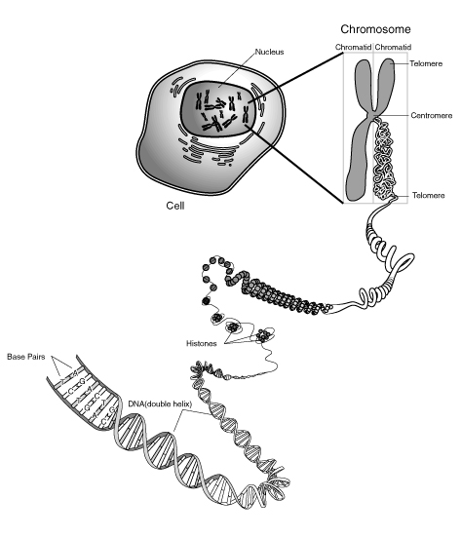
Chromosomes, genes and DNA
Chromosome
Base pairs
DNA
NIH - National Human Genome Research Institute

Slide 20
Genes
A chromosome consists of segments of DNA known as genes.
Genes contain the instructions for the construction of a particular protein, or RNA.
It is estimated that there are about 20,000–25,000 genes in the human genome (i.e. about 3 billion base pairs).

Slide 21
Introns and exons
Genes consist of introns and exons
Exons are sections of coding DNA – i.e. they contain instructions for making proteins.
Introns are sections of non-coding DNA (once called "junk DNA") – i.e. they do not contain instructions for making proteins but are now believed to serve other important functions.

Slide 22
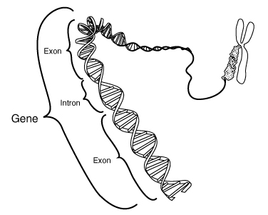
A gene contains coding (exon) and non-coding segments (introns)
NIH - National Human Genome Research Institute

Slide 23
The genetic code
The sequence of amino acids in a protein is defined by a gene and encrypted in the genetic code.

Slide 24
The genetic code
The sequence of bases in a gene is a code instructing the cell how to construct a particular protein – i.e. the number of amino acids and the order in which they are to be assembled.

Slide 25
Reading the code
The sequence of bases is read in groups of three called codons.
Thus the sequence:
AAGCCGTTTAGAGAGATTCCT
is read as:
AAG - CCG - TTT - AGA - GAG – ATT
Each codon represents one of the 20 different amino acids.

Slide 26
Protein synthesis
The construction of a protein from its constituent amino acids involves the processes of transcription and translation.

Slide 27
Transcription
Transcription is the process by which a gene's DNA sequence is copied into messenger RNA (mRNA).

Slide 28
RNA
RNA = Ribonucleic acid
RNA is similar in many respects to DNA except:
RNA consists of a single strand.
The sugar molecule is ribose rather than deoxyribose.
The base uracil (U) substitutes for thymine (T).

Slide 29
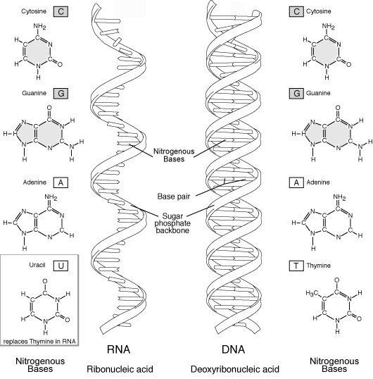
RNA
NIH - National Human Genome Research Institute

Slide 30
How transcription works
An enzyme unzips the DNA molecule exposing the nitrogen base code.
One exposed strand acts as a pattern, or template, for the construction of a molecule of messenger RNA (mRNA).
DNA polymerase works its way along the template strand and adds new nucleotides; U to A, A to T, C to G and G to C.

Slide 31
Thus, the DNA template sequence:
AAG - CCG - TTT - AGA - GAG – ATT
is transcribed to messenger RNA as:
UUC - GGC - AAA - UCU - CUC – UAA

Slide 32
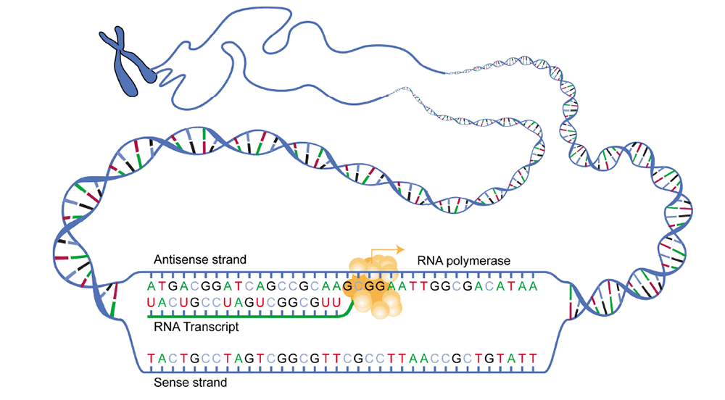
Transcription
NIH - National Human Genome Research Institute

Slide 33
Messenger RNA leaves the nucleus and carries the genetic message to the ribosomes, which are the protein-synthesising structures of the cell.

Slide 34
Translation
Translation is the process in which the genetic code carried by messenger RNA directs ribosomes to connected amino acids to each other to produce proteins.

Slide 35
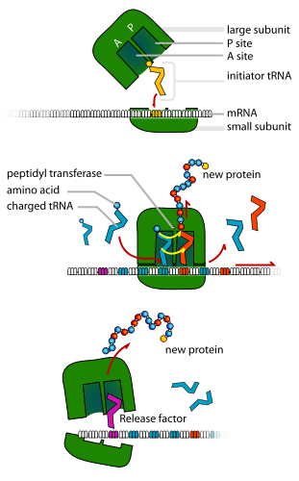
Proteins are assembled by ribosomes, which line the endoplasmic reticulum or float in the cytosol.
Image by LadyofHats

Slide 36
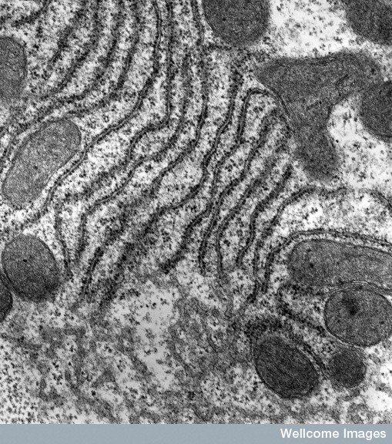
Ribosomes
Ribosomes are the tiny granular organelles lining the edoplasmic reticulum giving it a ‘rough’ appearance.
University of Edinburugh, Wellcome Images - Pete Jeffs

Slide 37
Transfer RNA
Individual molecules of transfer RNA have a sequence of three nucleotides (an anticodon) that binds to the complementary triplet (codon) in messenger RNA.
Each anticodon (more than one in some cases) can bind to a specific amino acid.
For example, the codon AAA in mRNA corresponds to the anticodon UUU in tRNA, and that tRNA carries the amino acid lysine.

Slide 38
Small RNA molecules (transfer RNA) transport individual amino acids to the ribosomes where they are assembled into proteins according to the instructions on the mRNA.
The specific order in which individual amino acids are joined to one another is determined by the sequence of the codons in the mRNA.

Slide 39
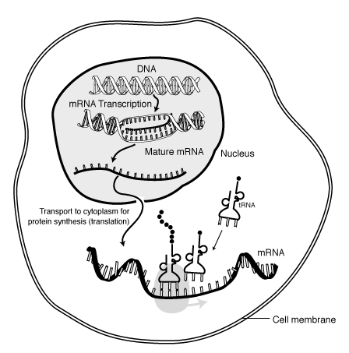
Translation
NIH - National Human Genome Research Institute

Slide 40
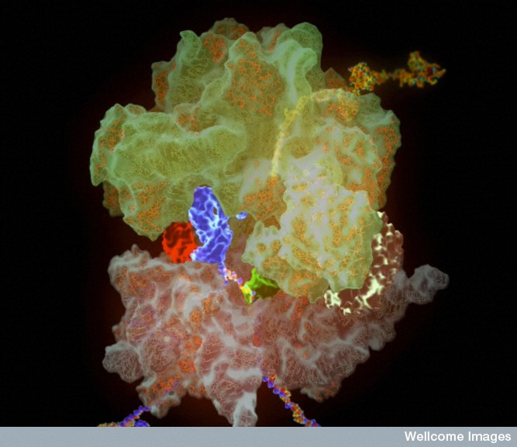
A molecular model of a ribosome showing the process of translation.
The transfer RNAs (tRNAs) shown in red, blue and green, read the genetic code in the messenger RNA (mRNA) and build up the protein from amino acid building blocks. The anticodon loops of the tRNAs bind to the long strand of mRNA looping up through a cleft in the small ribosomal subunit (brown). The amino acids are transferred onto the emerging polypeptide chain (yellow) deep within the large ribosomal subunit (soft green).

